Slide 1
Java Fundamentals

Slide 2

Procedure Oriented Programming
Large program is divided into smaller programs known as functions.
Functions transforms data from one to another.
Most of the functions share the global data.
Follows top-down approach in program design.

Slide 3

Object Oriented Programming
It allows us to decompose a program into a number of entities called Objects.
Object has Data and Functions (Methods) associated with it.
Data is hidden and can be accessed only by the methods associated with that object.
Follows bottom-up approach in program design.

Slide 4

Objects and Classes
Data Abstraction
Data Encapsulation
Inheritance
Polymorphism

Slide 5

General purpose, Object-Oriented Programming Language
Developed by Sun Microsystems
In 1991
Used to develop
  Stand-alone application
  Web application

Slide 6

Java does not include C keywords sizeof and typedef.
Java does not contain the data type struct and union.
Java does not define type modifiers auto, extern, register, signed and unsigned.
Java does not support an pointer type.
Java does not have a preprocessor.
Java adds many features required for Object-oriented Programming.

Slide 7
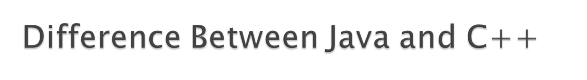
Java does not support Operator overloading.
Java does not have template calsses as in C++.
Java does not support multiple inheritance of classes.
Java does not support global variables.
Java does not use pointers.
There are no header files in Java
Java has replaced the destructor function with finalize() function.

Slide 8
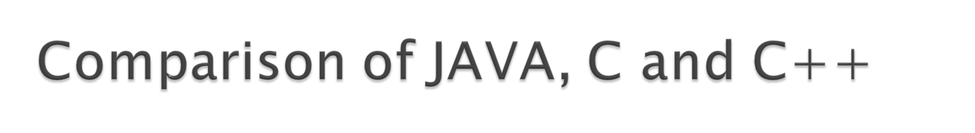
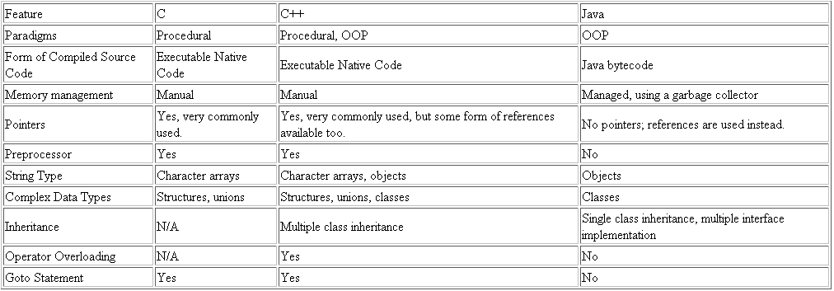

Slide 9

Simple
Secure
Portable
Object-Oriented
Robust
Multithreaded
Platform Independent/Architecture-neutral
Interpreted
High-Performance
Distributed

Slide 10

JDK 1.02 (1995)
JDK 1.1 (1996)
Java 2 SDK v 1.2 (JDK 1.2, 1998)
Java 2 SDK v 1.3 (JDK 1.3, 2000)
Java 2 SDK v 1.4 (JDK 1.4, 2002)
Java 2 SDK v 5.0 (JDK 1.5. 2004)

Slide 11

The Java Platform consists of two elements
  A software implementation of an imaginary computer called the Java Virtual Machine (JVM)
  The Java Application Programming Interface (Java API), which is a set of software components that provides the facilities you need to write a fully fledged interactive application in Java.
A Java compiler converts the Java source code that you write into a binary program consisting of bytecodes. Bytecodes are machine instructions for the Java Virtual Machine
Java interpreter inspects and translates the bytecodes for running program.

Slide 12

Compilers translates source code into machine code for a computer.
Java compiler translates source code into bytecode for Java Virtual Machine.
compiler converts the Java source code that you write into a binary program consisting of bytecodes.
Bytecodes are machine instructions for the Java Virtual Machine.
JVM exists inside computer memory and does all the major functions of real computer.
Source Code
Byte Code
Java
Program
Java
Compiler
Virtual
Machine

Slide 13
The virtual machine code is not machine code.
The machine code is generated by the Java interpreter.
Java interpreter is intermediate between virtual machine and real machine.
Interpreter is different for different machines.
Real Machine
Virtual Machine
Byte
Code
Java
Interpreter
Machine
Code

Slide 14
Editor
Program is created in
the editor and stored
on disk.
Phase 1
Disk
Disk
Compiler creates
bytecodes and stores
them on disk.
Phase 2
Compiler
Primary
Memory
Phase 3
Class Loader
Class loader puts
bytecodes in memory.
Disk
.
.
.
.
.
.
Primary
Memory
Phase 4
Bytecode Verifier
Bytecode verifier
confirms that all
bytecodes are valid
and do not violate
Java’s security
restrictions.
.
.
.
.
.
.
Interpreter
Primary
Memory
Interpreter reads
bytecodes and
translates them into a
language that the
computer can
understand, possibly
storing data values as
the program executes.
Phase 5
.
.
.
.
.
.

Slide 15

Java Systems
  Consist of environment, language, Java Applications Programming Interface (API), Class libraries
Java programs have five phases
  --Edit
    Use an editor to type Java program
    vi or emacs, notepad, Jbuilder, Visual J++
    .java extension
  -Compile
    Translates program into bytecodes, understood by Java interpreter
    javac command: javac myProgram.java
    Creates .class file, containing bytecodes (myProgram.class)

Slide 16
Java programs have five phases (continued)
  Loading
    Class loader transfers .class file into memory
      Applications - run on user's machine
      Applets - loaded into Web browser, temporary
    Classes loaded and executed by interpreter with java command
    java Welcome
    HTML documents can refer to Java Applets, which are loaded into web browsers. To load,
    appletviewer Welcome.html
      appletviewer is a minimal browser, can only interpret applets

Slide 17
Java programs have five phases (continued)
  Verify
    Bytecode verifier makes sure bytecodes are valid and do not violate security
    Java must be secure - Java programs transferred over networks, possible to damage files (viruses)
  Execute
    Computer (controlled by CPU) interprets program one bytecode at a time
    Performs actions specified in program

Slide 18

Integers: This group includes byte, short, int, and long, which are for whole valued signed numbers.
Floating-point numbers: This group includes float and double, which represent numbers with fractional precision.
Characters: This group includes char, which represents symbols in a character set, like letters and numbers.
Boolean: This group includes boolean, which is a special type for representing true/false values.

Slide 19

Name | Width | Range
long | 64 | –9,223,372,036,854,775,808 to 9,223,372,036,854,775,807
int | 32 | –2,147,483,648 to 2,147,483,647
short | 16 | –32,768 to 32,767
byte | 8 | –128 to 127
Integers
Types
Name | Width | Range
double | 64 | 4.9e–324 to 1.8e+308
float | 32 | 1.4e−045 to 3.4e+038
Floating
Point
Types

Slide 20

In Java, the data type used to store characters is char.
char in Java is not the same as char in C or C++. In C/C++, char is 8 bits wide. This is not the case in Java.
Instead, Java uses Unicode to represent characters. For this purpose, it requires 16 bits.
Thus, in Java char is a 16-bit type. The range of a char is 0 to 65,536.
Unicode defines a fully international character set that can represent all of
the characters found in all human languages.

Slide 21

Used for logical values. It can have only one of two possible values, true or false.
This is the type returned by all relational operators, such as a < b.
boolean is also the type required by the conditional expressions that govern the control statements such as if and for.

Slide 22

Escape Sequence | Description
\’ | Single quote
\” | Double quote
\\ | Backslash
\r | Carriage return
\n | New line (also known as line feed)
\f | Form feed
\t | Tab
\b | Backspace

Slide 23

The variable is the basic unit of storage in a Java program.
A variable is defined by the combination of an identifier, a type, and an optional initializer.
All variables have a scope, which defines their visibility, and a lifetime.
Declaring a variable:
type identifier [ = value][, identifier [= value] ...] ;
Initializing a variable:
double pi = 3.14159; Static Initialization
int sum = n1 + n2; Dynamic Initialization

Slide 24

Java provides a rich operator environment.
Most of its operators can be divided into the following groups:
  Arithmetic (+, -, *, /, %)
  Relational (<, >, ==, !=)
  Logical (&&, |, !)
  Assignment (var op=exp)
  Increment / Decrement (++, --)
  Conditional
  Bitwise ( &, |, ^, ~, <<, >>, >>>, <<<)
  Special (instanceof, dot(.) )

Slide 25

Instanceof Operator
  Object reference operator.
  Returns true if the object on the left-hand side is an instance of the class given on the right-hand side.
  Example :
  stud1 instanceof student;
  is true if object stud1 belongs to class student, otherwise it is false
Dot Operator (.)
  Used to access the instance variables and methods of class.
  Example :
  stud1.name
  stud1.avg();

Slide 26

Automatic Conversion :
  When one type of data is assigned to another type of variable, an automatic type conversion will take place in following two conditions.
    The two types are compatible.
    The destination type is larger than the source type.
  Widening conversion
  Example :
  int a;
  float b;
  float sum=a+b;

Slide 27
Explicit Type Conversion :
  To create a conversion between two incompatible types, you must use a cast.
  General form :
  (target-type) value
  Narrowing conversion
  Example:
  int a;
  byte b;
  b = (byte) a;

Slide 28

Java defines several type promotion rules that apply to expressions.
They are as follows.
  All byte and short values are promoted to int.
  If one operand is a long, the whole expression is promoted to long.
  If one operand is a float, the entire expression is promoted to float.
  If any of the operands is double, the result is double.

Slide 29

An array is a group of like-typed variables that are referred to by a common name.
Arrays in Java work differently than they do in C/C++.
A specific element in an array is accessed by its index.
Arrays offer a convenient means of grouping related information.
Arrays of any type can be created and may have one or more dimensions.

Slide 30

One-Dimensional Arrays :
  General Form :
  type var-name[ ];
  var-name = new type[size];
  Example :
  int number[];
  number=new int[10];
Multi-Dimensional Arrays :
  General Form :
  type var-name[ ][];
  var-name = new type[size][size];
  Example :
  int table[][];
  table=new int[4][4];
Alternative Array Declaration Syntax:
type[ ] var-name;
Here, the square brackets follow the type specifier, and not the name of the array variable.
Example:
int[] number = new int[3];
char[][] table = new int[3][4];

Slide 31

The package java.io contains the classes that provide the foundation for Java’s support for stream I/O.
Class | Description
InputStream | The base class for byte stream input operations.
OutputStream | The base class for byte stream output operations.

Slide 32

Console output is most easily accomplished with print( ) and println( ).
These methods are defined by the class PrintStream which is the type of the object referenced by System.out.
System is the name of a standard class that contains objects for the standard I/O devices of your system.
The object out represents the standard output stream.
Example:
System.out.println(“Hello”);

Slide 33

Java does not have a generalized console input method that parallels the standard C function scanf( ) or C++ input operators.
In Java, console input is accomplished by reading from System.in.
To obtain a character-based stream that is attached to the console , We need to create object of DataInputStream Class
  DataInputStream d=new DataInputStream(System.in);
  Char choice=d.read();
  String Name=d.readLine();

Slide 34

Same as C/C++
Decision making and Branching
  If statement
  Switch statement
  Conditional operator statement
Decision making and Looping
  While statement
  Do-while statement
  For statement

Slide 35
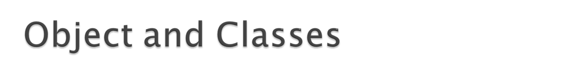
Java is true object-oriented language therefore structure of all Java program is classes.
Class provide a method for packing together a group of logically related data items and functions that work on them.
a class is a template for an object, and an object is an instance of a class.
Each class contains:
  Fields—These are variables that store data items that typically differentiate one object of the class from another.
  Methods—These define the operations you can perform for the class. Methods typically operate on the fields.

Slide 36

General form:
class classname
{
type instance-variable1;
type instance-variable2;
...type instance-variableN;
type methodname1(parameter-list)
{
// body of method
}
type methodname2(parameter-list)
{
// body of method
}
}

Slide 37

Obtaining objects of a class is a two-step process.
  Declare a variable of the class type. This variable does not define an object.
  Acquire an actual, physical copy of the object and assign it to that variable using the new operator. The new operator dynamically allocates memory for an object and returns a reference to it.
  Example :
  class class-car;
  class-var = new classname( );
  In Java, all class objects must be dynamically allocated.

Slide 38

  class test
  {
  public static void main (String args[])
  {
  System.out.println("Hello");
  }
  }

Slide 39
The public keyword is an access specifier, which allows the programmer to control the visibility of class members. When a class member is preceded by public, then that member may be accessed by code outside the class in which it is declared.
The keyword static allows main( ) to be called without having to instantiate a particular instance of the class. This is necessary since main( ) is called by the Java interpreter before any objects are made.
The keyword void simply tells the compiler that main( ) does not return a value
In main( ), there is only one parameter, String args[ ] declares a parameter named args, which is an array of instances of the class String. In this case, args receives any command-line arguments present when the program is executed.

Slide 40

Text Editor
Java Source
Code
Javac
Java Class
File
Java
Java Program
Output

Slide 41

Special type of method that enables an object to initialize itself when it is created.
  Constructors have same name as class.
  It does not have any return type.
  They are invoked automatically when the objects are created.
  We can overload constructor.
  Basically two type of constructor.
    Default constructor
    Parameterized constructor

Slide 42

To create methods that have the same name, but different number of parameters or different types of parameters.
Used when objects are required to perform similar task but using different input parameters.
Methods return type does not play any role in this.
Also known as polymorphism.

Slide 43

Without parameters / return types
In-built data type as parameters
Returning data from methods
Object as parameters
Returning objects
recursion

